Slide 1



Structural Analysis of
a Research Paper on Intracranial Monitoring
Presenters：ZL.Ni ; BH.Guo ; H.Shi ; HY.Wang ; JS.Chen ; WJ.Cao

Slide 2
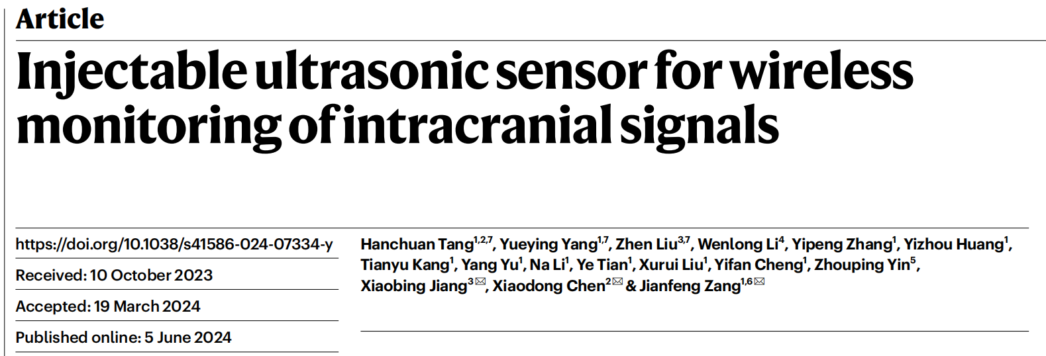
CONTENTS
01
Abstract
02
Introduction
03
Design
& Methods
04
Characterization
& Methods
Tang, H., Yang, Y., Liu, Z. et al. Injectable ultrasonic sensor for wireless monitoring of intracranial signals. Nature 630, 84–90 (2024). https://doi.org/10.1038/s41586-024-07334-y
05
Conclusion

Slide 3
01
PART
Abstract

Slide 4
Background
Research Background
Wired clinical instruments that use percutaneous leads are accurate but are susceptible to
infection, patient mobility constraints and potential surgical complications during
removal.
Wireless implantable devices provide greater operational freedom but
include issues such as limited detection range, poor degradation and difficulty in
size reduction in the human body.
Significance
Direct and precise monitoring of intracranial physiology holds immense importance
in delineating injuries, prognostication and averting disease

Slide 5
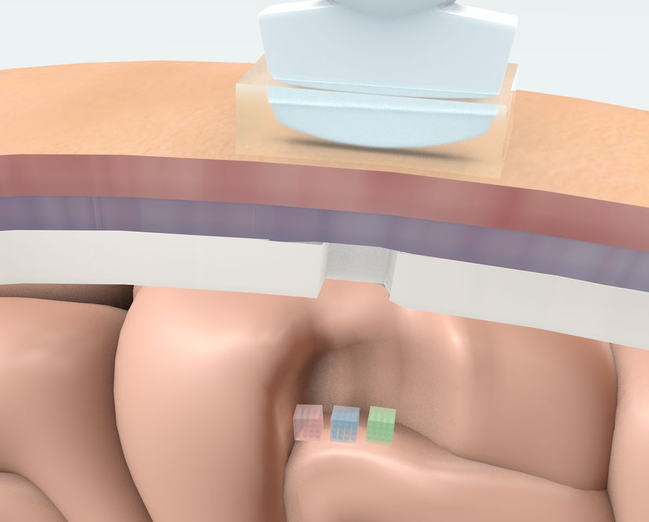
Solution
The metagel sensors are cubes 2 × 2 × 2 in size that encompass both biodegradable and stimulus-responsive hydrogels and periodically aligned air columns with a specific acoustic reflection spectrum. Implanted into intracranial space with a puncture needle, the metagel deforms in response to
physiological environmental changes, causing peak frequency shifts of reflected ultrasound waves that can be wirelessly measured by an external ultrasound probe.
The metagel sensor can independently detect intracranial pressure, temperature, pH and flow rate, realize a detection depth of 10 cm and almost fully degrade within 18 weeks. Animal experiments on rats and pigs indicate promising multiparametric sensing performances on a par with conventional non-resorbable wired clinical benchmarks.

Slide 6
02
PART
Introduction

Slide 7
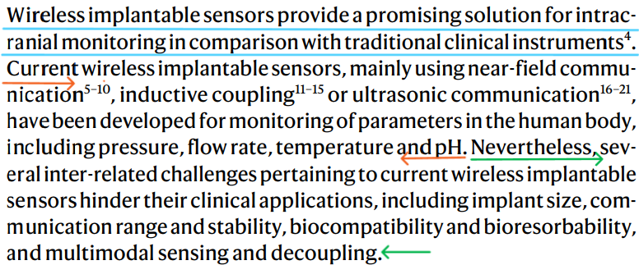



Research Status
Current Wireless Implantable Sensors
the great significance of wireless implantable sensors
the status of current wireless sensors
technical method
several inter-related challenges

Slide 8
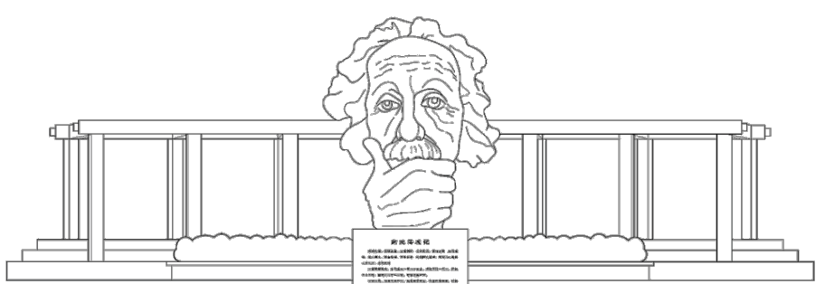
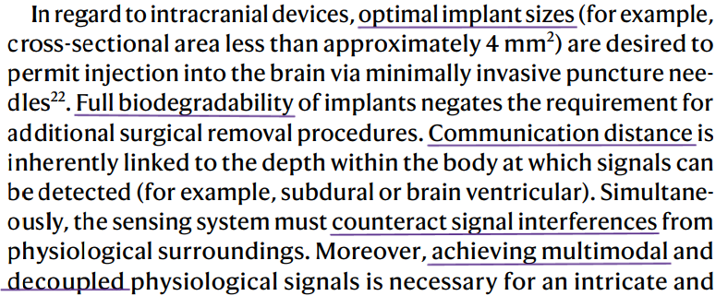
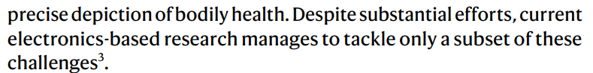
Research Status
Technical Challenges of Existing Technology
Implant sizes
Full biodegradability
Communication distance
Counteraction against interferences
Multimodal and Decouple
But current electronics-based research can only tackle a subset of these challenges

Slide 9
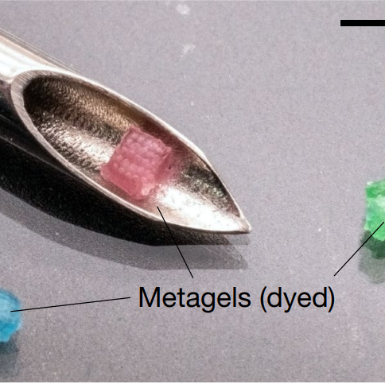
Research Hypothesis
trait：possess extraordinary acoustic properties for long-distance wireless sensing and communication without the addition of electronic components
propose：hypothesize the soft acoustic metamaterials incorporating hydrogel as base material and a wearable ultrasound device
Use a new metamaterials:metagel
inserted into the body by using a conventional puncture needle
wirelessly monitoredrich intracranial physiological signals
Soft Acoustic Metamaterials

Slide 10


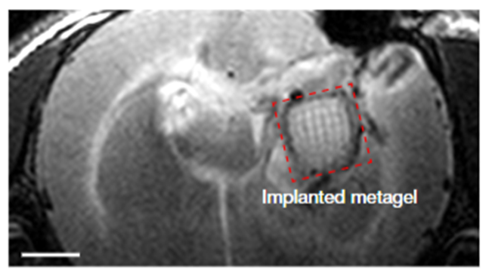
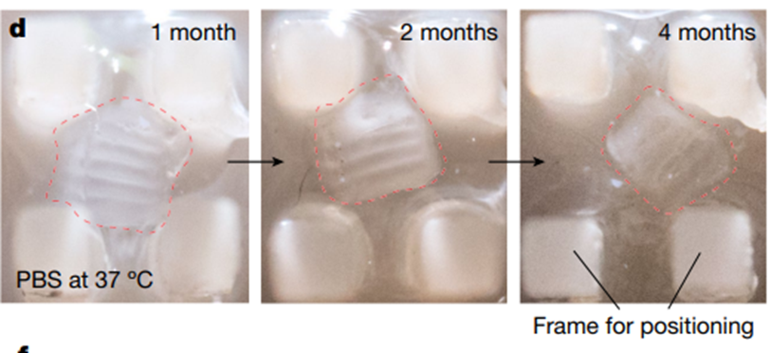
Research Hypothesis
The objective to develop a system for ultrasonic monitoring
To avoid infection, minimize the restriction on patient activity as much as possible, and prevent the occurrence of surgical complications.
The advantage of creating this sensor
1、the metagel can naturally degrades win the PBS solution at 37 ℃ within 4 months
2、It can detect various signals (pressure, temperature, pH and flow rate)

Slide 11
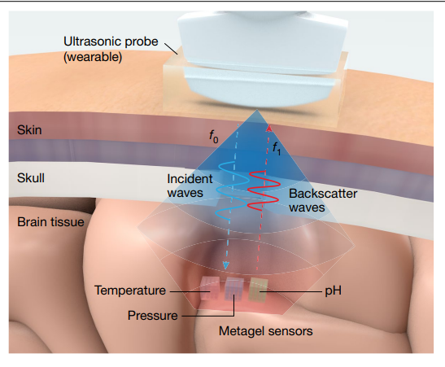
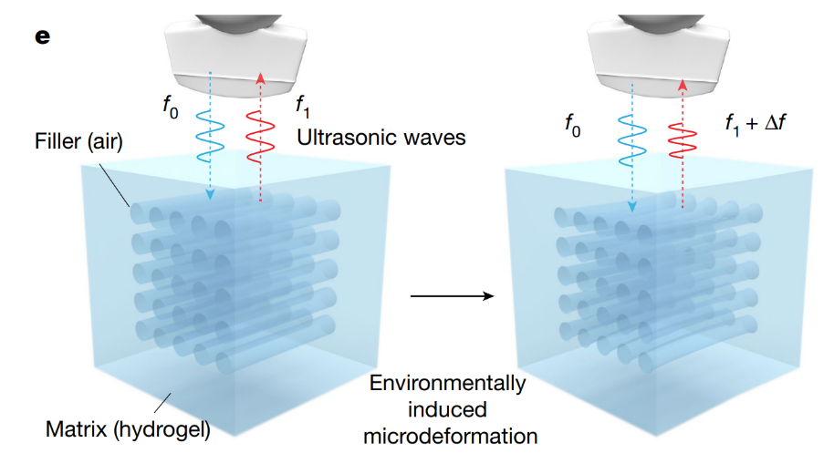
Research Objective
Injectable Metagel Sensor
Ultrasonic Monitoring(work method))
The metagel sensors, which are cubes of 2 × 2 × 2 mm^3 in size, are designed to be implanted into the intracranial space using a puncture needle.
This deformation causes a shift in the peak frequency of the reflected ultrasonic waves from f1f1​ to f1+Δff1​+Δf, which can be wirelessly measured by an external ultrasonic probe.

Slide 12
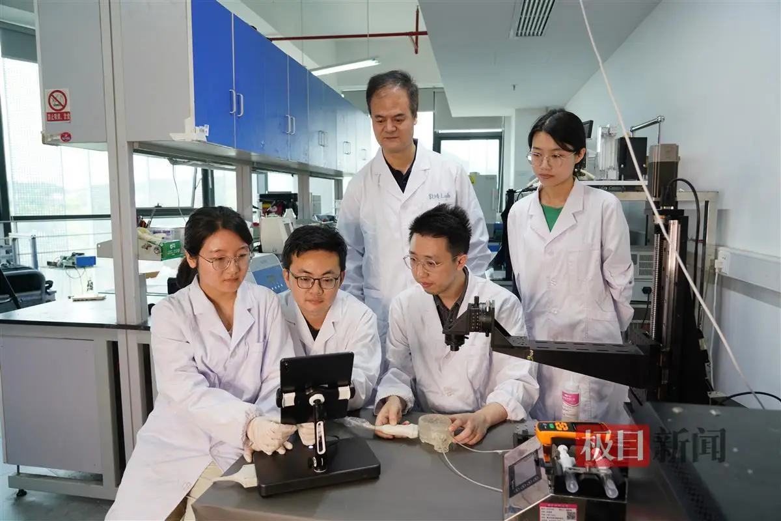
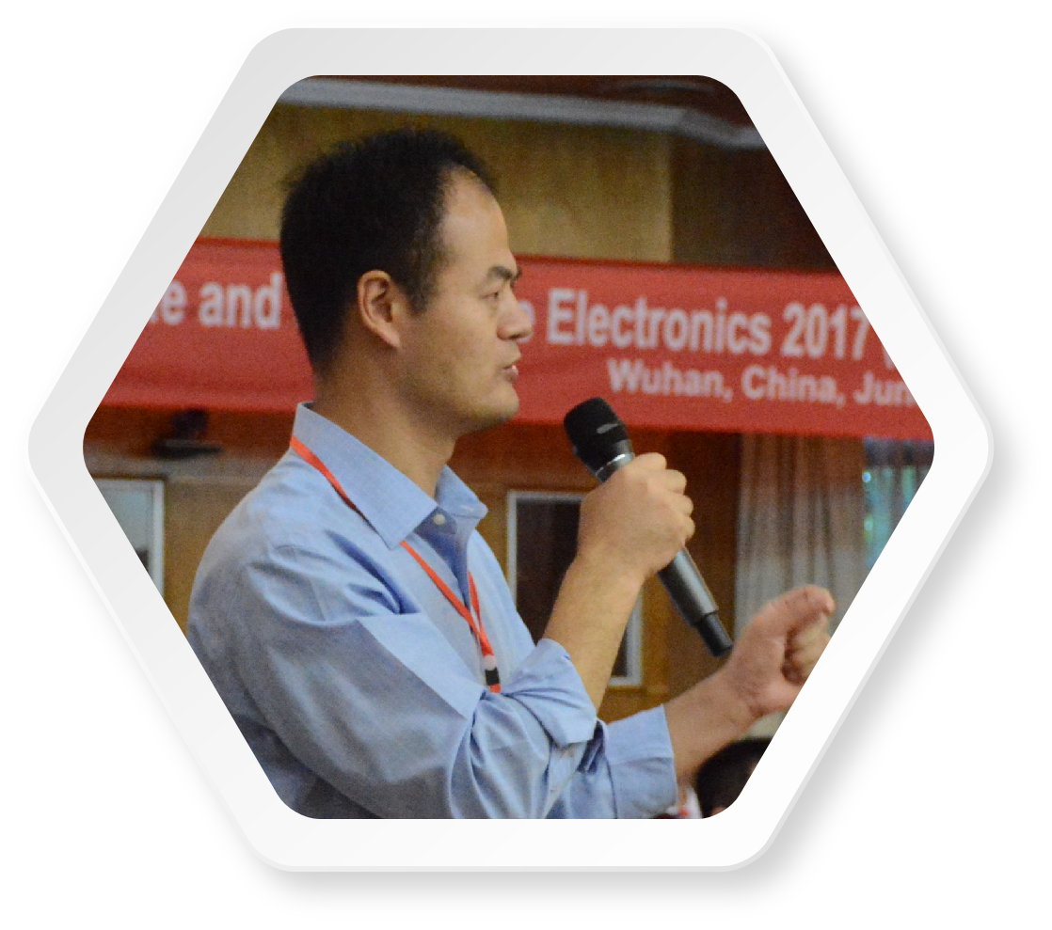
04
PART
Design

Slide 13
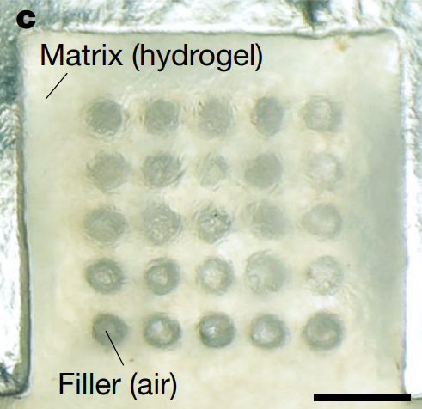
Metagel Sensor - the Structural Design
01
Hydrogel Matrix
Crosslinked network: Hydrogels consist of a three-dimensional network of crosslinked polymer chains, with pores filled with water and other solutes.
Air Columns
02
Periodic array: Air columns are uniformly arranged within the metagel, forming a periodic array structure.
Notes:
What I need to say:
The metagel sensor, composed of a hydrogel matrix and periodically arranged air columns, forms a soft phononic crystal with tunable acoustic reflection spectra.
This structural design confers exceptional acoustic reflectivity upon the metagel.
The bandgap properties of the metagel can be modulated by adjusting the lattice constant and filling ratio, allowing for selective reflection of ultrasound waves within specific frequency ranges.
Furthermore, the hydrogel matrix can be functionalized with stimuli-responsive components, enabling the metagel to detect and monitor changes in intracranial pressure, temperature, pH, and flow rate.
The biocompatibility and biodegradability of the metagel matrix ensure minimal immune response and eliminate the need for surgical removal.

Slide 14
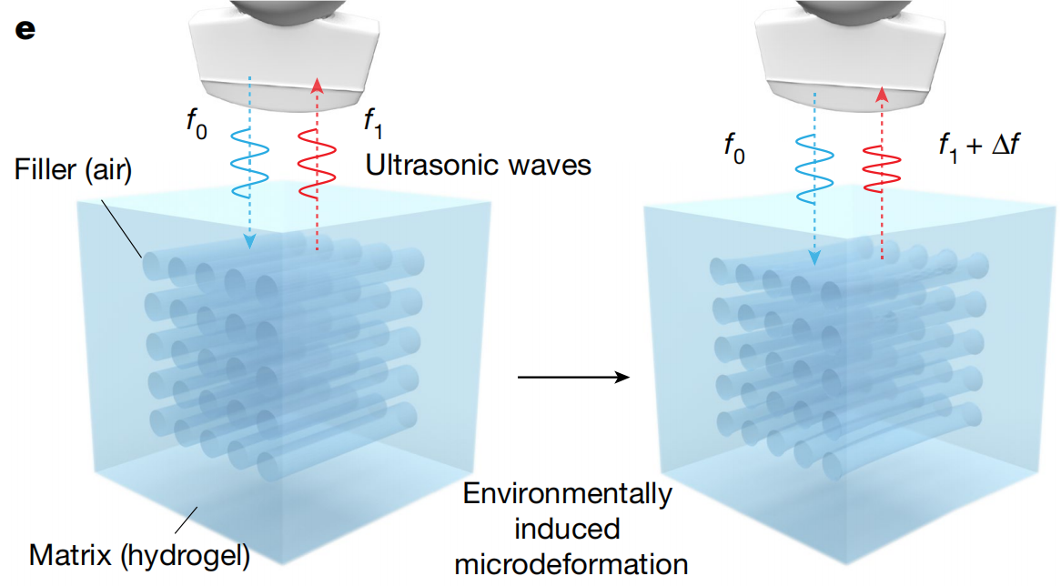
Metagel Sensor - the Design of Micro-deformation
?
Why do Metagel sensors have sensing capabilities?
Stimuli responsiveness
Hydrogels can be engineered to respond to specific environmental stimuli (e.g., temperature, pH, light, electric fields), altering their volume, shape, or chemical properties accordingly.
Acoustic bandgap
The periodic arrangement of air columns generates an acoustic bandgap, resulting in strong reflection of ultrasound waves within specific frequency ranges.

Slide 15
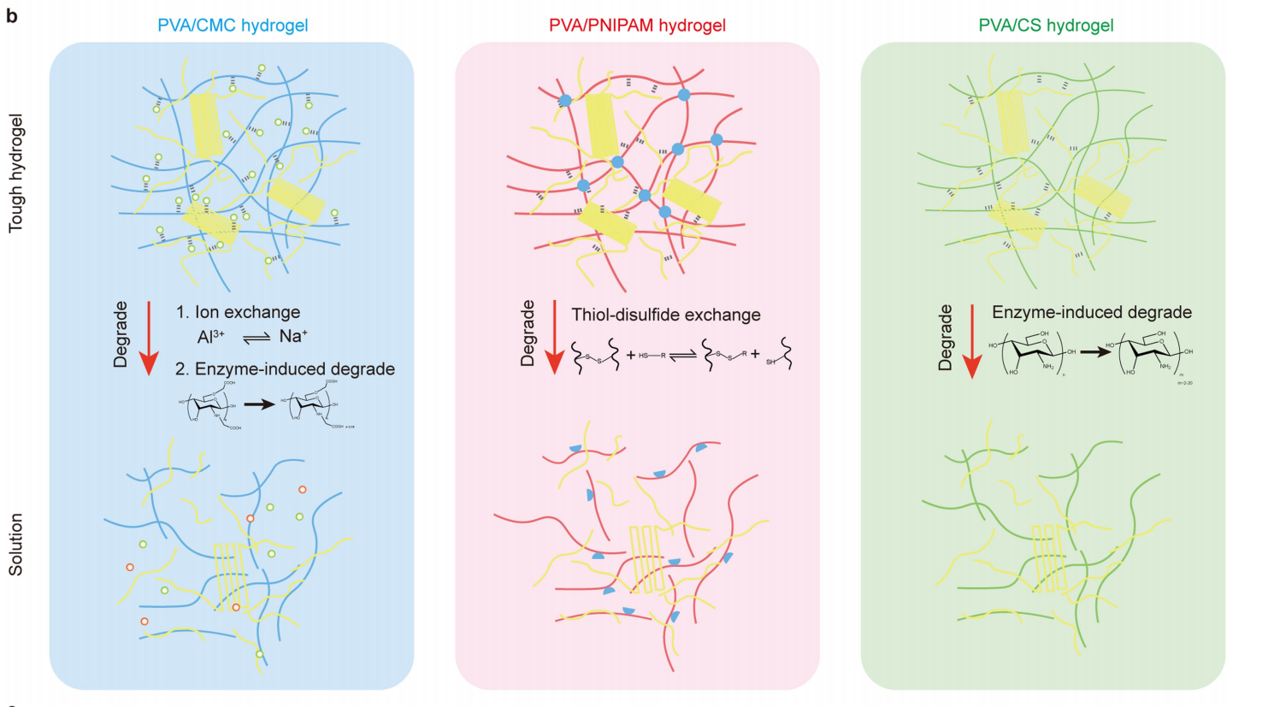
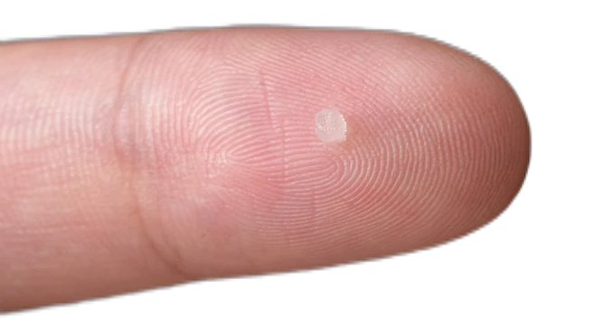
Design with Biocompatibility and biodegradability
Metagels are fabricated from biocompatible materials, ensuring minimal immune responses or inflammation upon implantation into the human body.
Furthermore, the inherent biodegradability of metagels allows for complete degradation within the body, eliminating the need for surgical removal.
Notes:
The biocompatibility and biodegradability of the metagel matrix ensure minimal immune response and eliminate the need for surgical removal.

Slide 16
05
PART
Characterization

Slide 17
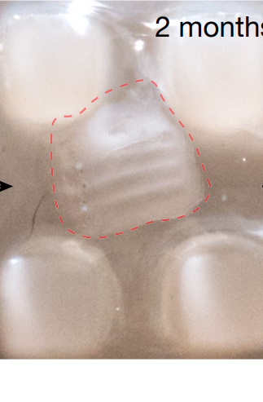
Shape and Structure
1：hydrogel composed of a polyvinyl alcohol/carboxymethyl chitosan (PVA/CMC) double network（聚乙烯醇/羟甲基壳聚糖双网络构成的水凝胶）used to detect pressure changes
2：a PVA/poly(N-isopropylacrylamide) (PVA/PNIPAM) double-network hydrogel（聚乙烯醇/聚N-异丙基烯酰胺）sense temperature changes
3：a PVA/chitosan (CS) double-network hydrogel（聚乙烯醇/壳聚糖）detect shifts in pH

Slide 18
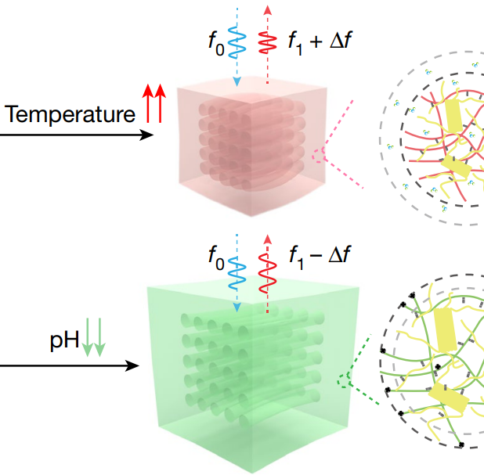
Multiple Signals and Decoupling
1.pressure/2.flow rate：
External pressure compresses the air column within the metagel, leading to an increase in ultrasound reflection peak frequency.
3.temperature /4.pH :
A stimulus-responsive component incorporated in the hydrogel matrix endures the ability of the metagel to sense other signals.

Slide 19
Multiple Signals and Decoupling
Technology Foundation:
The pulse repetition frequency of
the ultrasonic probe can reach 10 kHz,permitting cyclic sequential
scanning of diverse metagels with time intervals as short as 0.1 ms.
Results:
The concurrent assessment of response attributes for three metagels under a particular single environmental factor becomes possible.

Slide 20
Long Communication Distance
Due to the robust sound
reflection attributes of metagels and facile tissue penetration of ultrasonic sound, the communication distance between metagels and ultrasound
probe can be greater than 10 cm.

Slide 21
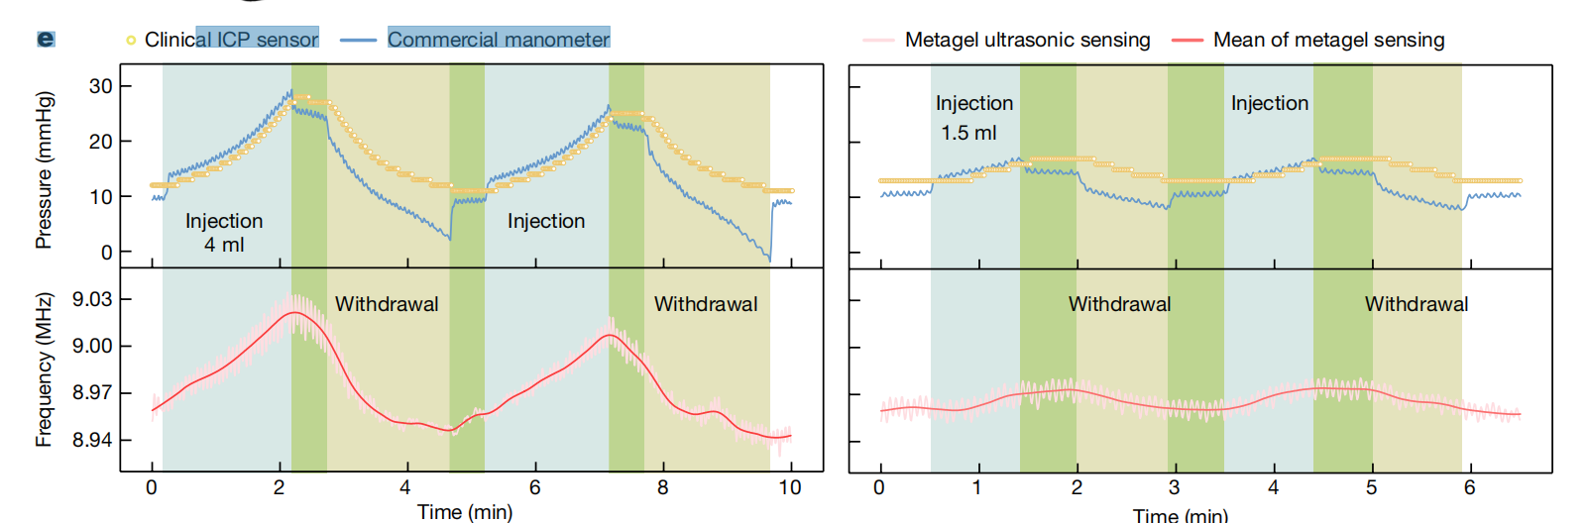
Stability and Reliability
Metagel sensors demonstrated robust ultrasound performance under fatigue testing with 2,600 pressurization cycles
The system generates minimal heat, with tissue temperature remaining at 22 °C over 60 min of ultrasound sensing and thereby ensuring safety for human application.

Slide 22
06
PART
Conclusion

Slide 23
key findings
propose a new implantable wireless-sensing approach :metagel sensor
metagedeformation-induced, ultrasound frequency-shift mechanism
for accurate monitoring of intracranial signals,
including pressure, temperature, pH and flow rate.
offers advantages specifically
implant size, decoupled multiple signals and biodegradability.

Slide 24
Implications
opens diverse possibilities
(1)metagel sensors can be injected into the body,
obviating the need for extensive surgery;
(2)a multitude of signals within the body can be precisely, continuously and wirelessly monitored
(3) following the intended monitoring duration, the metagel naturally undergoes degradation eliminating the necessity for surgical extraction

Slide 25




Future directions
these outcomes will drive advancements in the integration of diagnostics and therapeutics, as well as active health management.
incorporating responsive components for specific detections
prognosis guidance
disease prevention
………………
wireless monitoring of physiological
parameters in various bodily locations

Slide 26
Thanks for Listening!
Presenters：ZL.Ni ; BH.Guo ; H.Shi ; HY.Wang ; JS.Chen ; WJ.Cao
Presenters：

